Slide 1
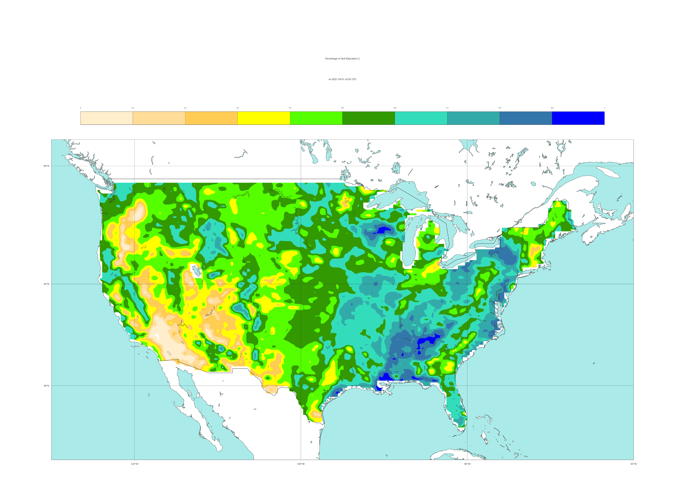

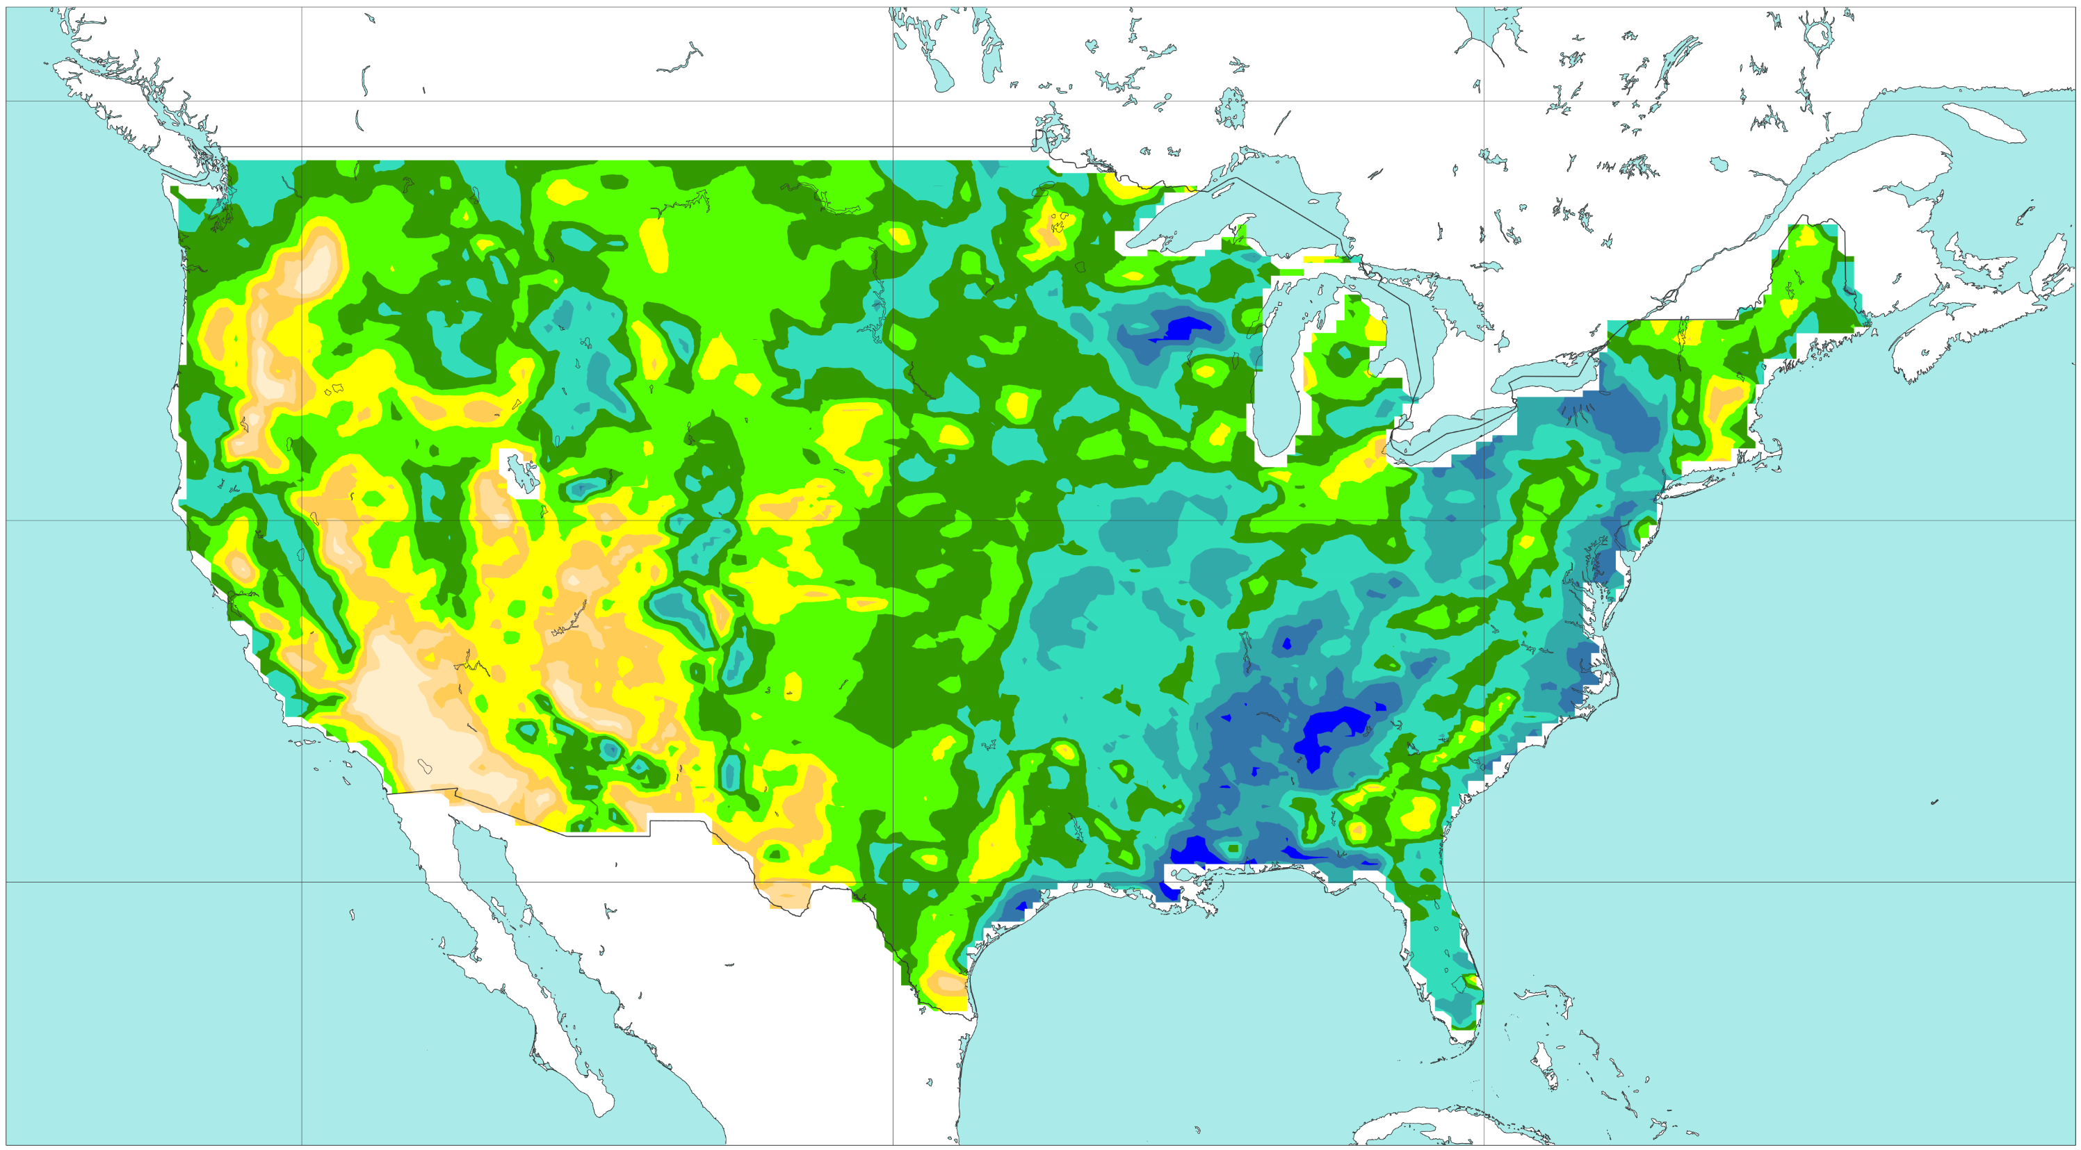




Feature variables for data-driven model
Antecedent percentage of soil saturation (ERA5)
VT: 2021-09-01 at 00 UTC
[%]
0
10
20
30
40
50
60
70
80
90
100
a) Reanalysis
b) Forecasts: 2021-08-31 - 00 UTC (t+0,t+24)
50 °N
40 °N
30 °N
c) Forecasts: 2021-08-30 - 00 UTC (t+24,t+48)
d) Forecasts: 2021-08-29 - 00 UTC (t+48,t+72)
50 °N
40 °N
30 °N
e) Forecasts: 2021-08-28 - 00 UTC (t+72,t+96)
f) Forecasts: 2021-08-27 - 00 UTC (t+96,t+120)
50 °N
40 °N
30 °N
120 °W
100 °W
80 °W
120 °W
100 °W
80 °W

